Slide 1

Parallel Processing
DATA PIPELINE
By Mitushi Vishwakarma
Email id : mitushi.vish@gmail.com
Data Engineering Batch

Slide 2

Table of
CONTENTS
Project Statement
Project Overview
Azure Resources Used
Technologies Used
Architecture Diagram
About Data Set
How It Works
Execution

Slide 3

Integrate Azure Databricks with Azure Data Factory to load data into Azure Data Lake Gen 2 using parallel processing capabilities of Databricks for efficient data loading.
Project Statement

Slide 4

PROJECT OVERVIEW
The objective of this project is to develop a robust and efficient data pipeline in Azure for processing and analyzing household power consumption data. The pipeline will leverage parallel processing capabilities to enhance performance and scalability, ultimately loading the processed data into Azure Data Lake Storage for further analysis and insights generation.

Slide 5


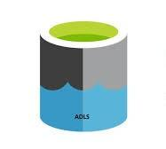

Azure resources used
Technologies Used
Azure Databricks
Azure Data Factory
Azure Data Lake Storage Gen 2
PySpark

Slide 6
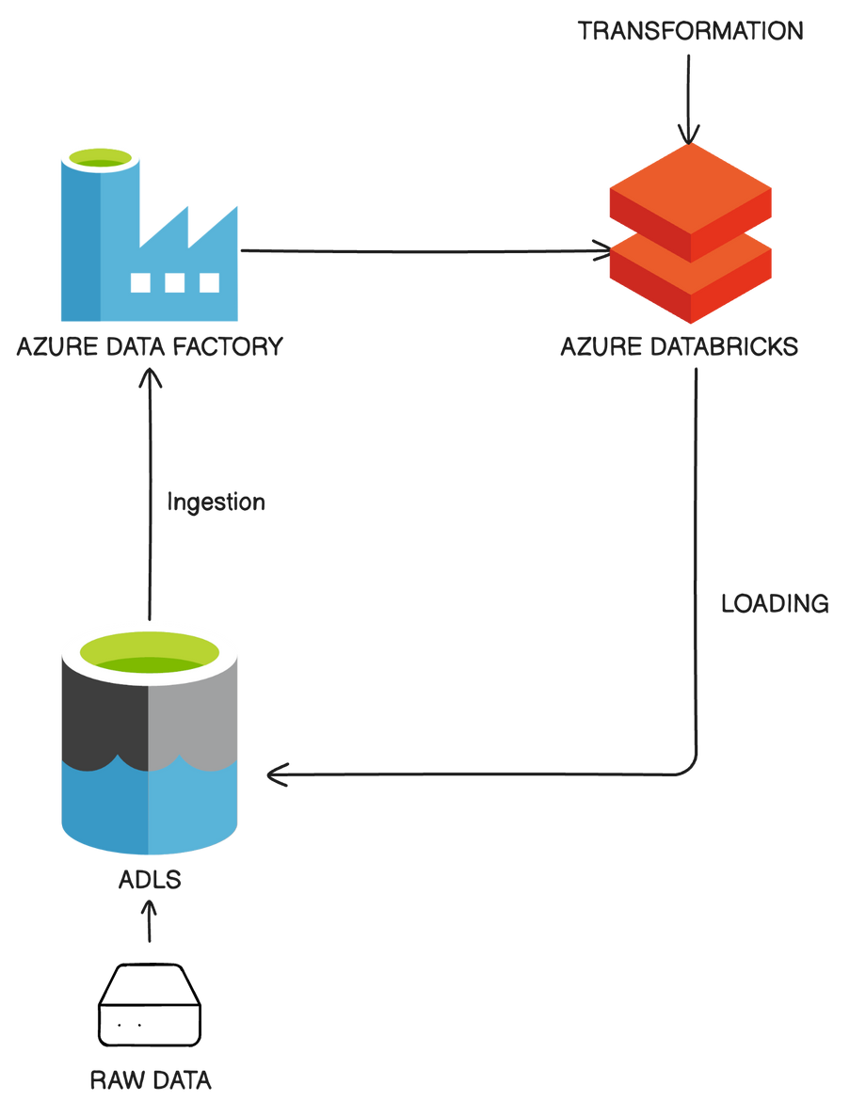
Architecture
Diagram

Slide 7

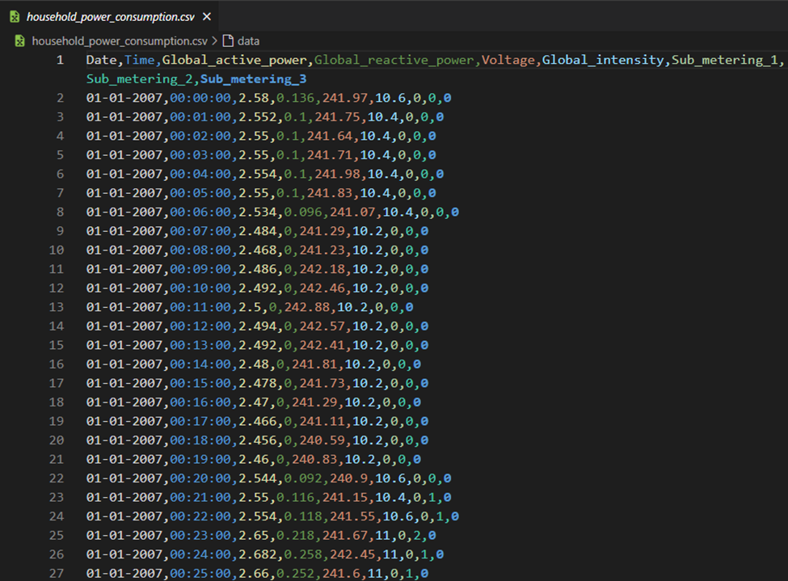
ABOUT DATASET
Individual household electric power consumption dataset collected via submeters placed in 3 distinct areas of a home
This household electricity consumption dataset contains 260,640 measurements gathered between January 2007 and June 2007 (6 months). It is a subset of a larger, original archive that contains 2,075,259 measurements gathered between December 2006 and November 2010 (47 months).

Slide 8
Set up Azure Data Lake Gen2
Create an Azure Databricks Workspace
Create an Azure Data Factory
How it
Link Azure Databricks to Azure Data Factory
WORKS
Develop Data Processing Logic in Databricks
Create Data Factory Pipeline
Schedule and Monitor

Slide 9
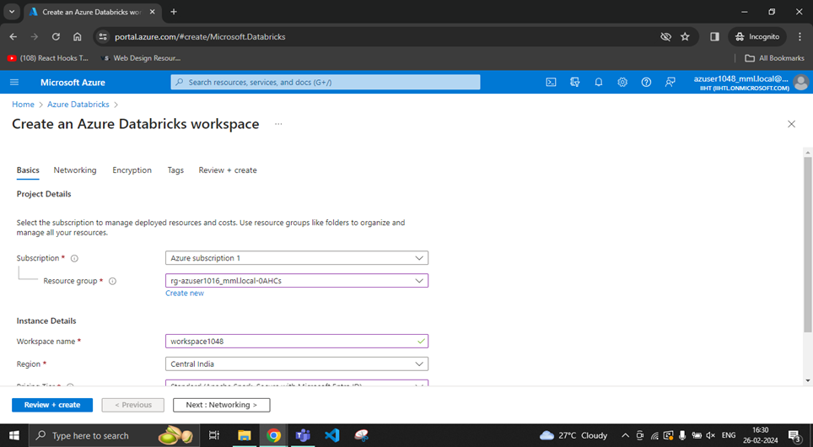
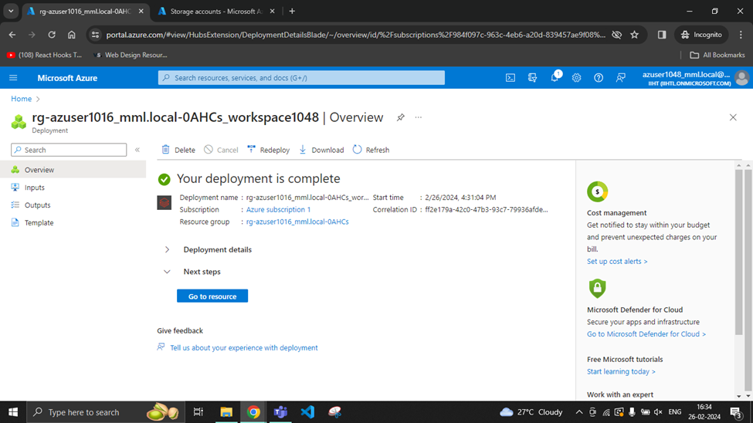
Create an Azure Databricks Workspace

Slide 10
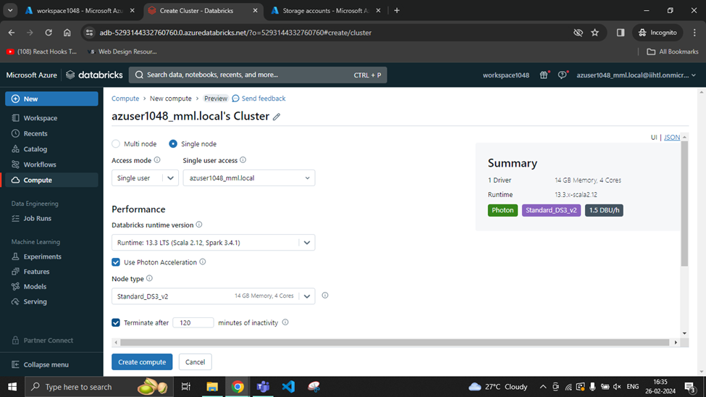
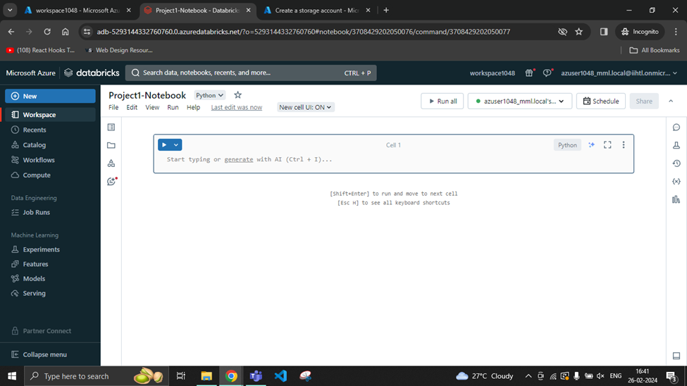
In Databricks,
create a cluster and a notebook

Slide 11
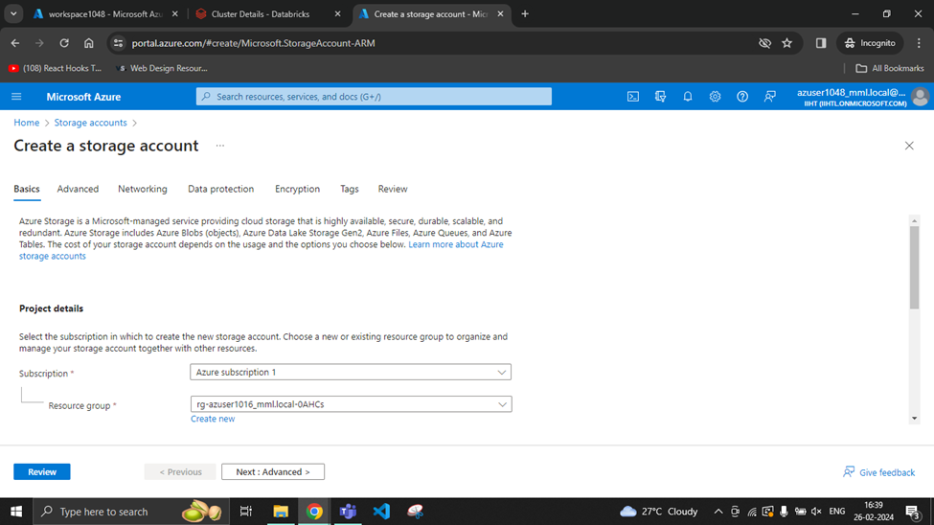
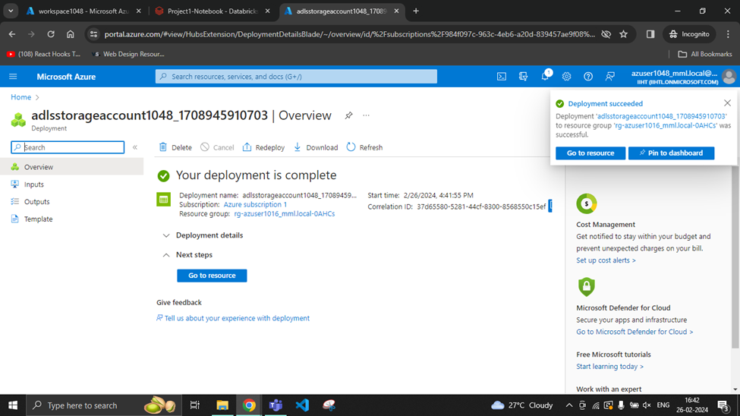
Create an
ADLS Account

Slide 12
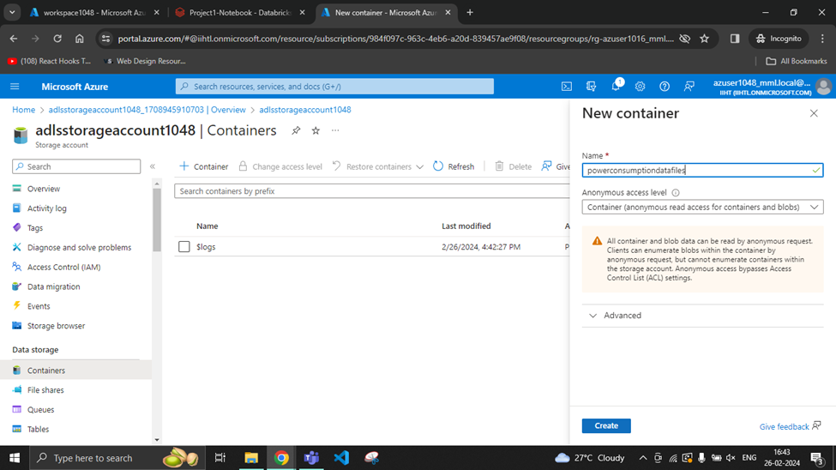
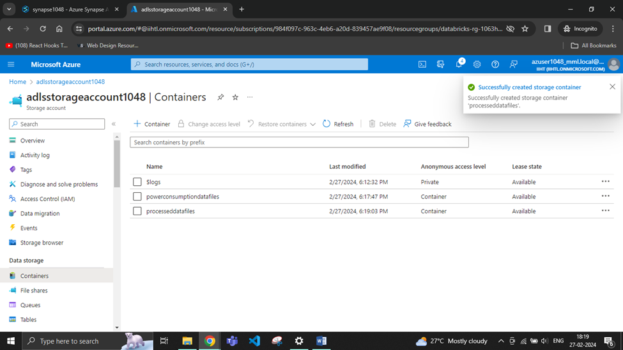
Create a
container in ADLS

Slide 13
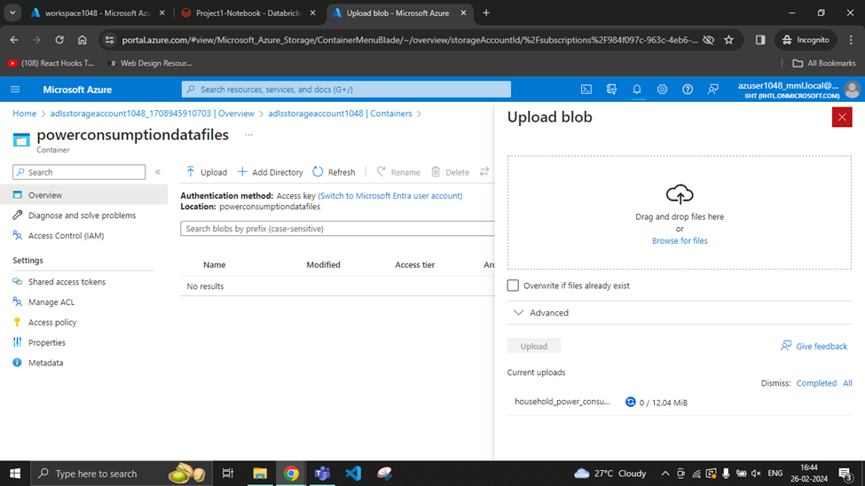
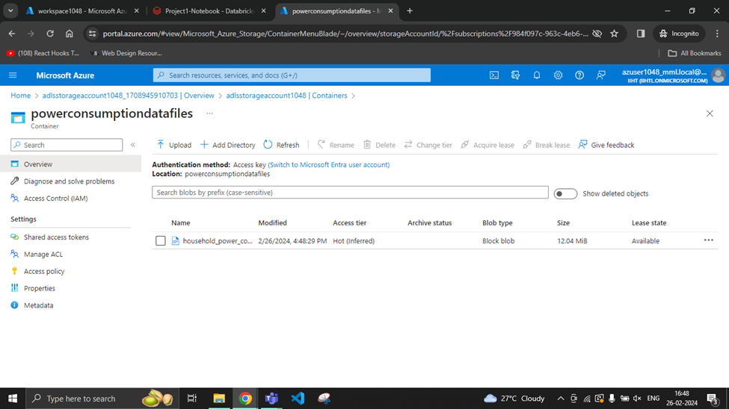
Upload the respective files in the container

Slide 14
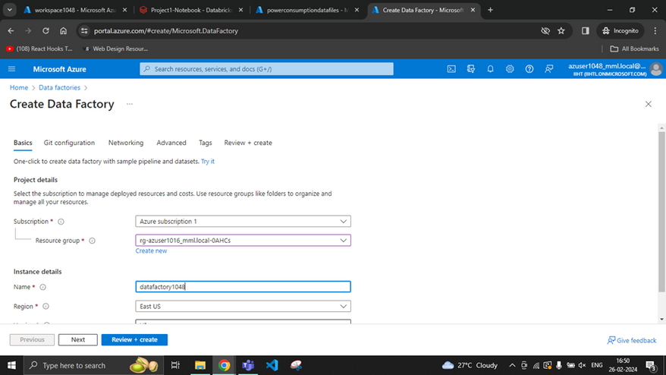
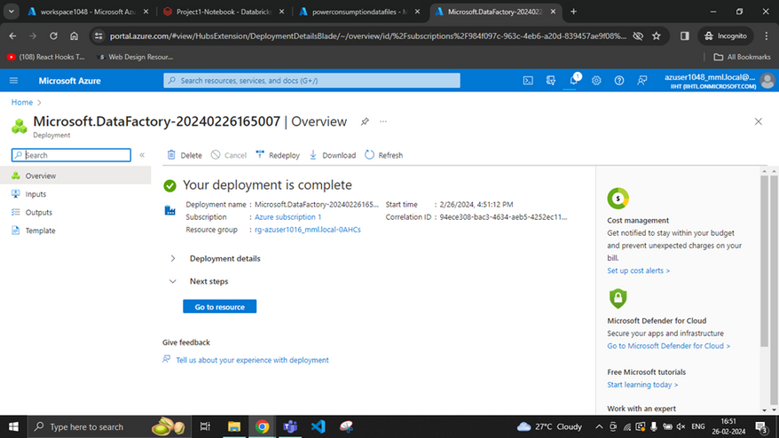
Create an
Azure Data Factory

Slide 15
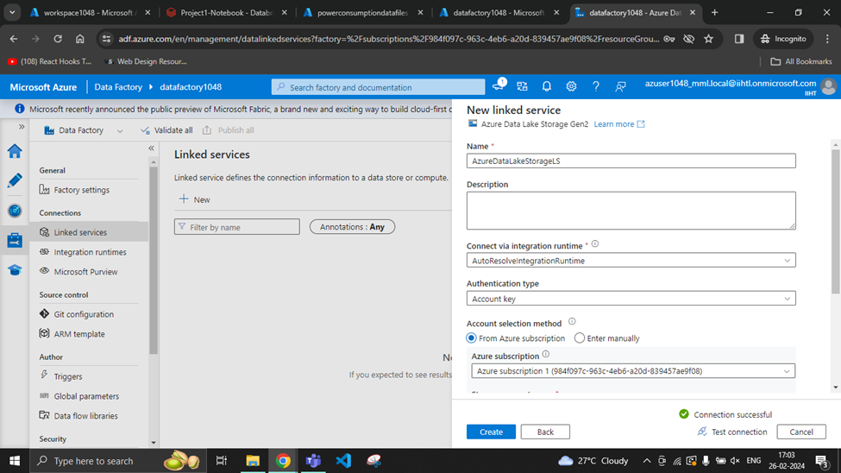
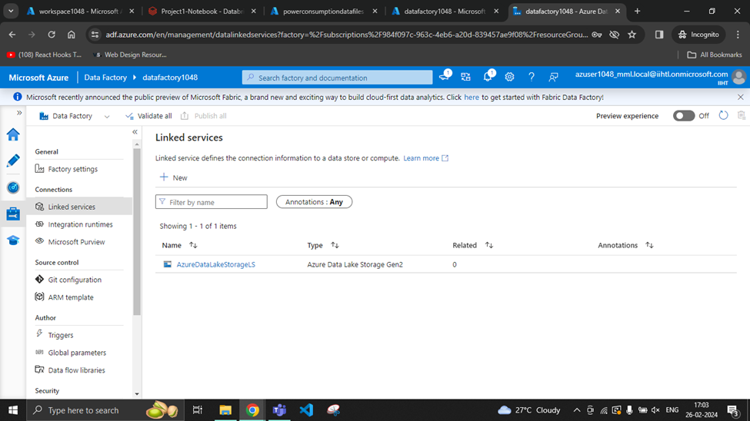
In ADF, create linked service for ADLS

Slide 16
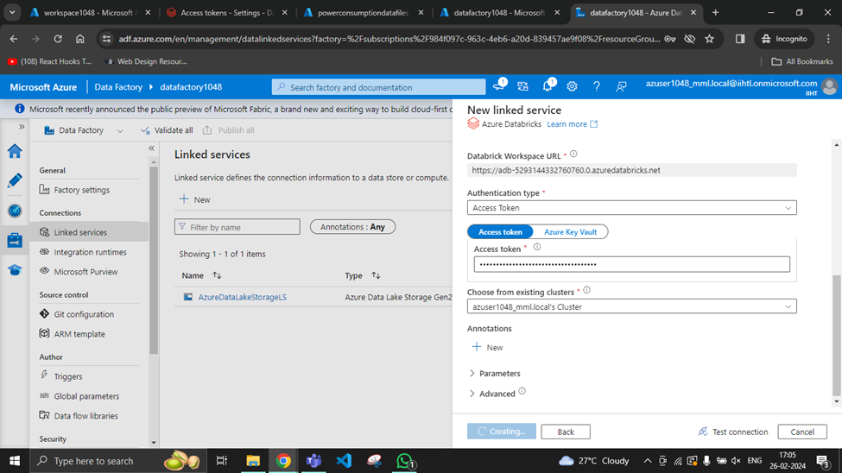
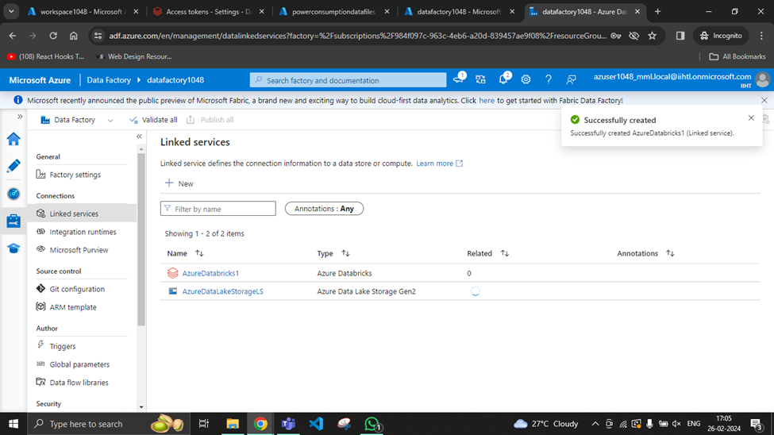
In ADF, create linked service for Databricks

Slide 17
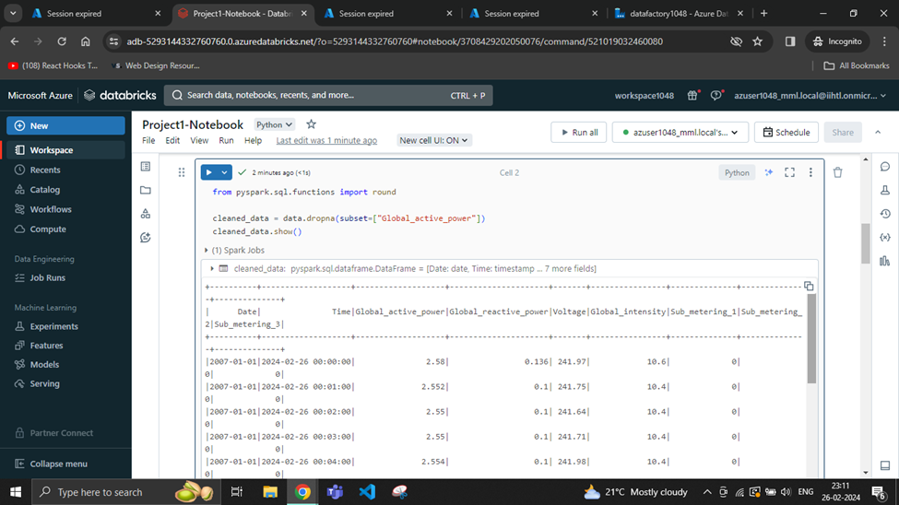
Configure the Databricks Notebook
with required logic

Slide 18
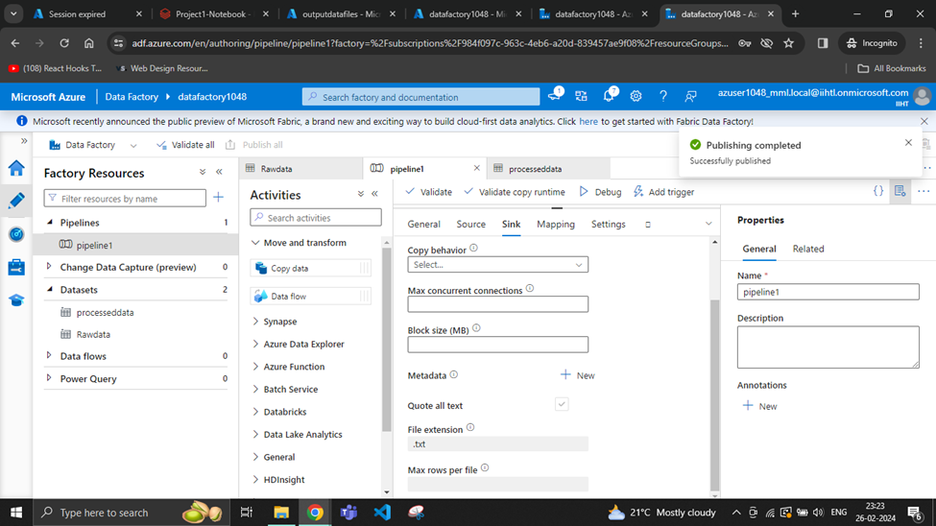
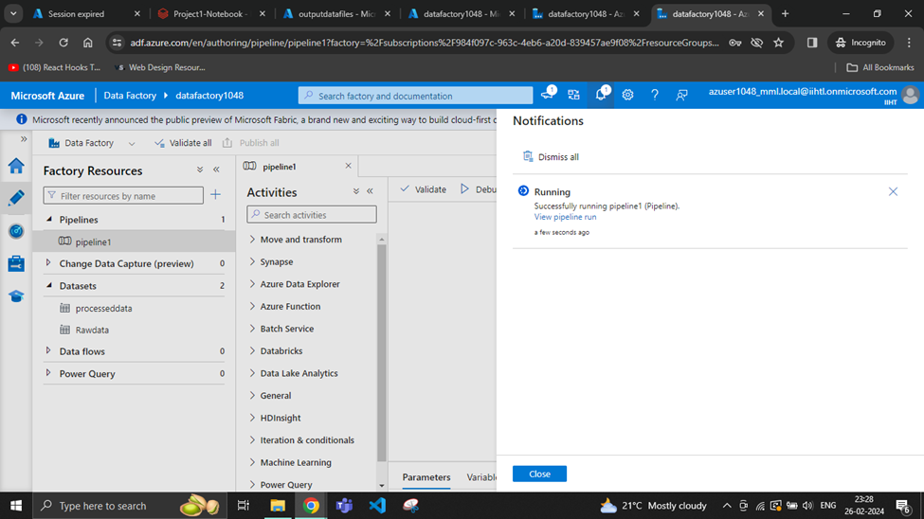
In ADF, create
a data pipeline,
and run it

Slide 19
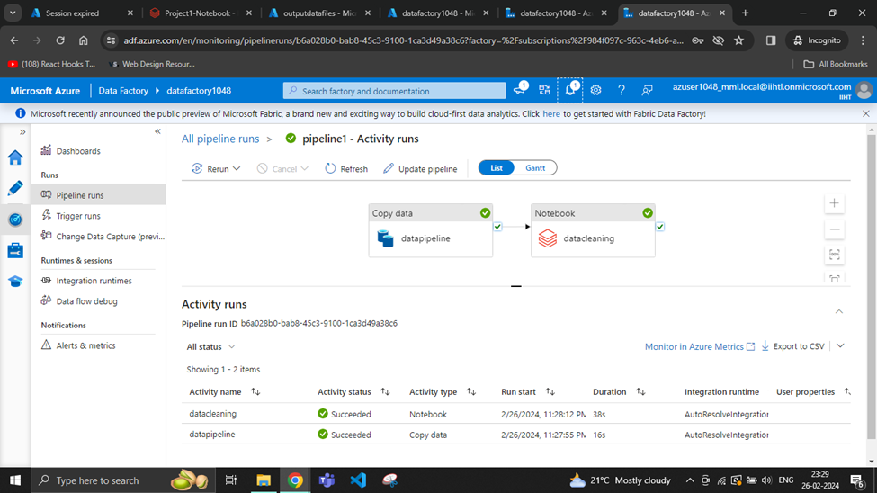
Pipeline ran successfully

Slide 20
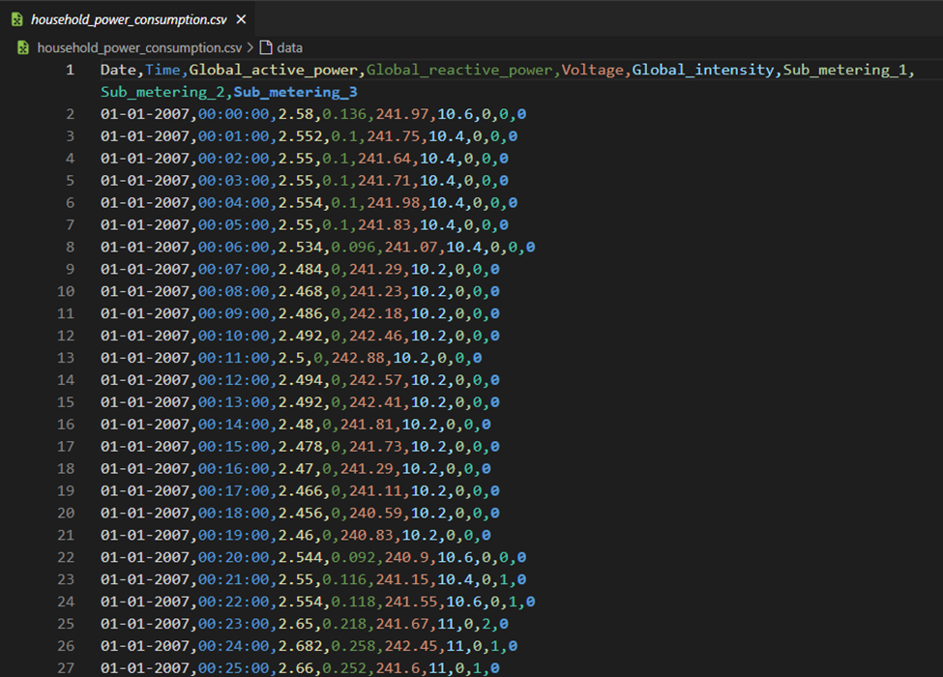
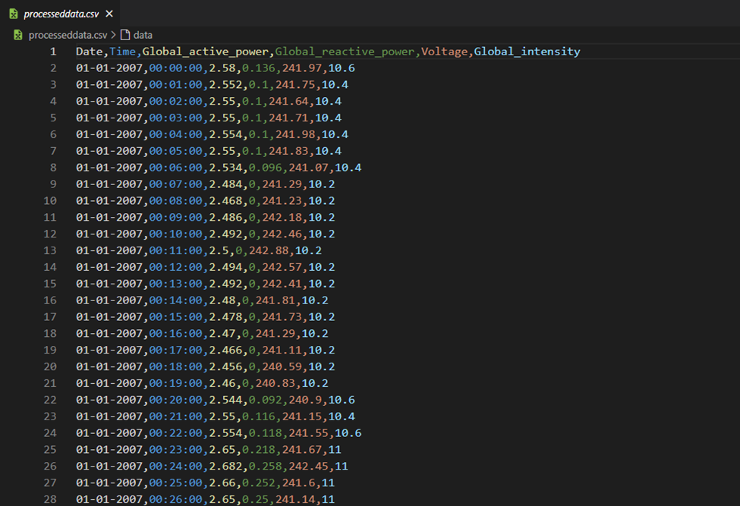
Raw Data vs Processed Data

Slide 21

CONCLUSION
In conclusion, this project successfully demonstrated parallel processing using Azure Data Factory’s Data Pipeline for processing, analysis and movement of household power consumption data. This project has successfully developed a robust and efficient data pipeline in Azure for processing and analyzing household power consumption data. The data was ingested from the source by Azure Data Factory, cleaned and transformed by the Azure Databricks Notebook and the loaded to ADLS with the copy activity in the data pipeline.

